Slide 1
Singular Value Decomposition

Slide 2
SVD stands for Singular Value Decomposition. It's a fundamental concept in linear algebra and plays a crucial role in various fields like signal processing, image compression, machine learning, and data analysis.

Slide 3
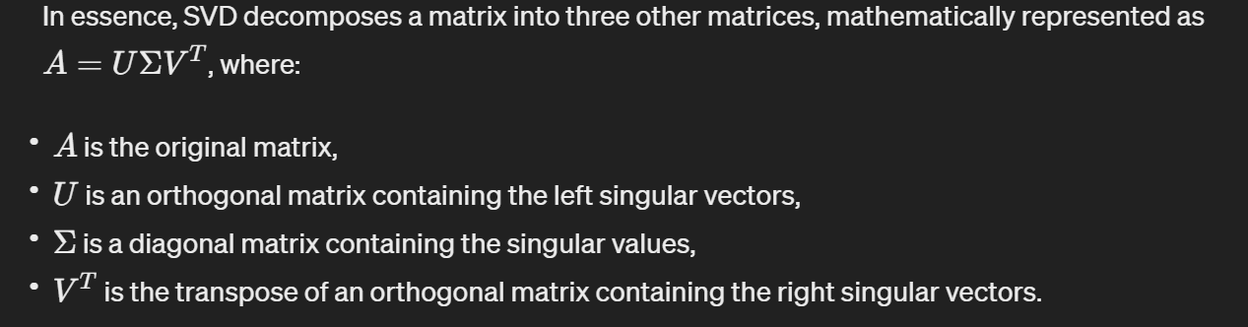

Slide 4
SVD has several important applications. For instance, in dimensionality reduction, it's used to find the principal components of a dataset. In image compression, it's used to reduce the size of an image while preserving its essential features. In recommendation systems, it's used for collaborative filtering. And in solving linear systems of equations, it can provide stable and accurate solutions.

Slide 5
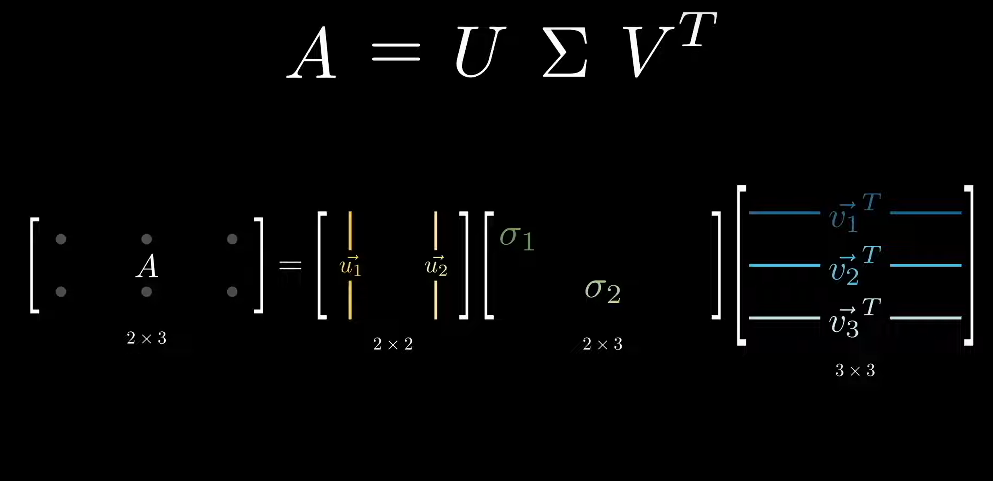

Slide 6
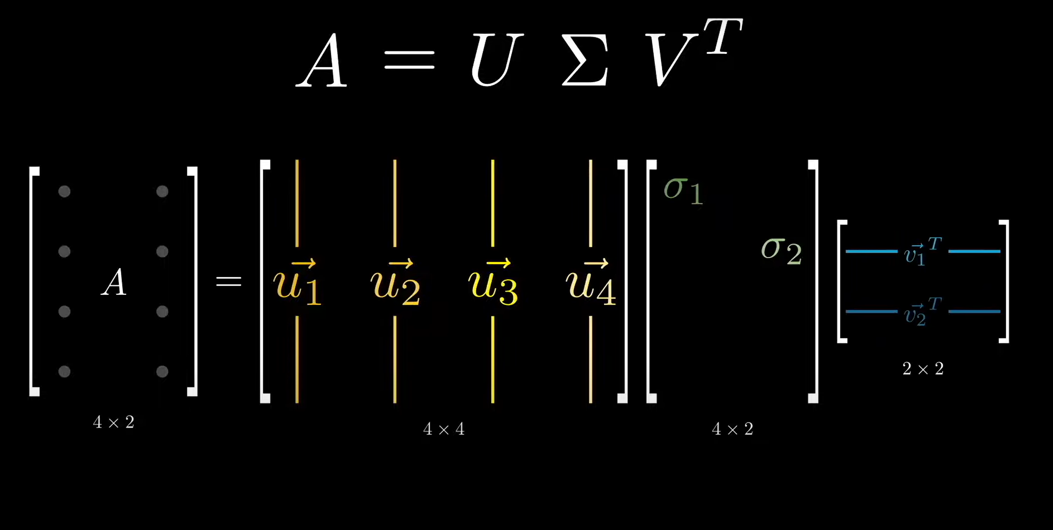

Slide 7
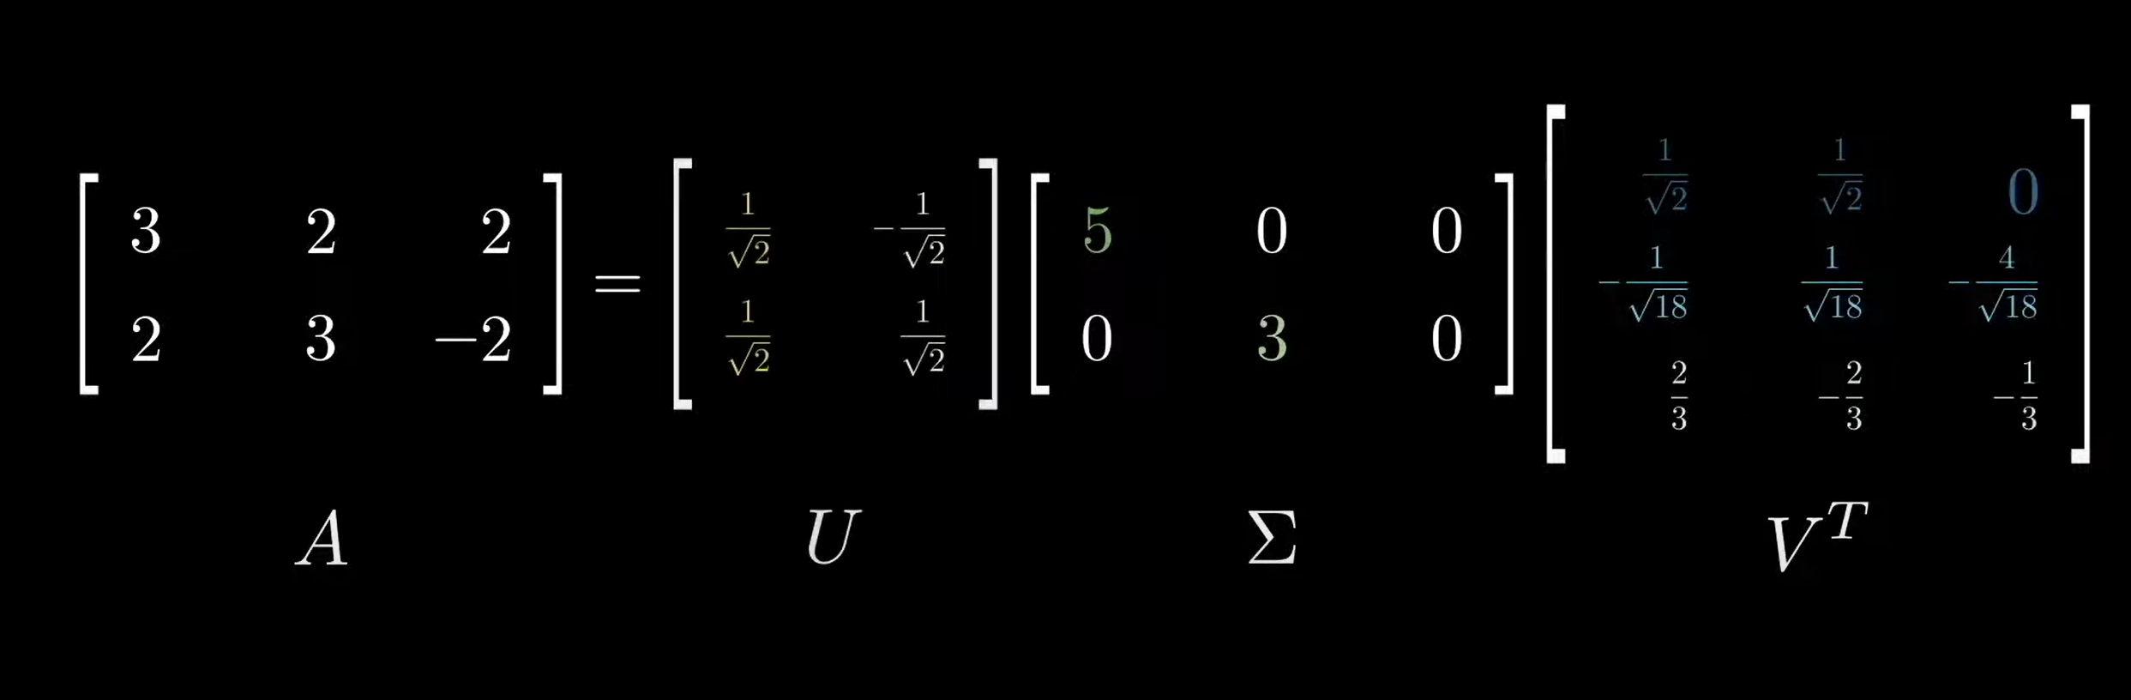

Slide 8
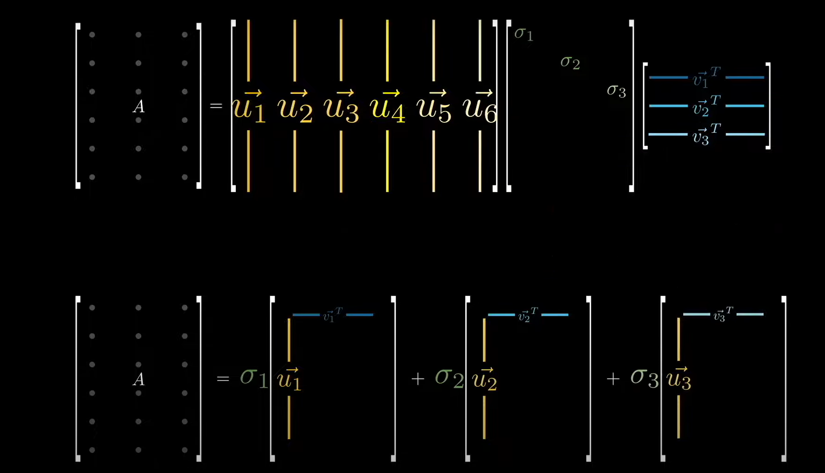

Slide 9
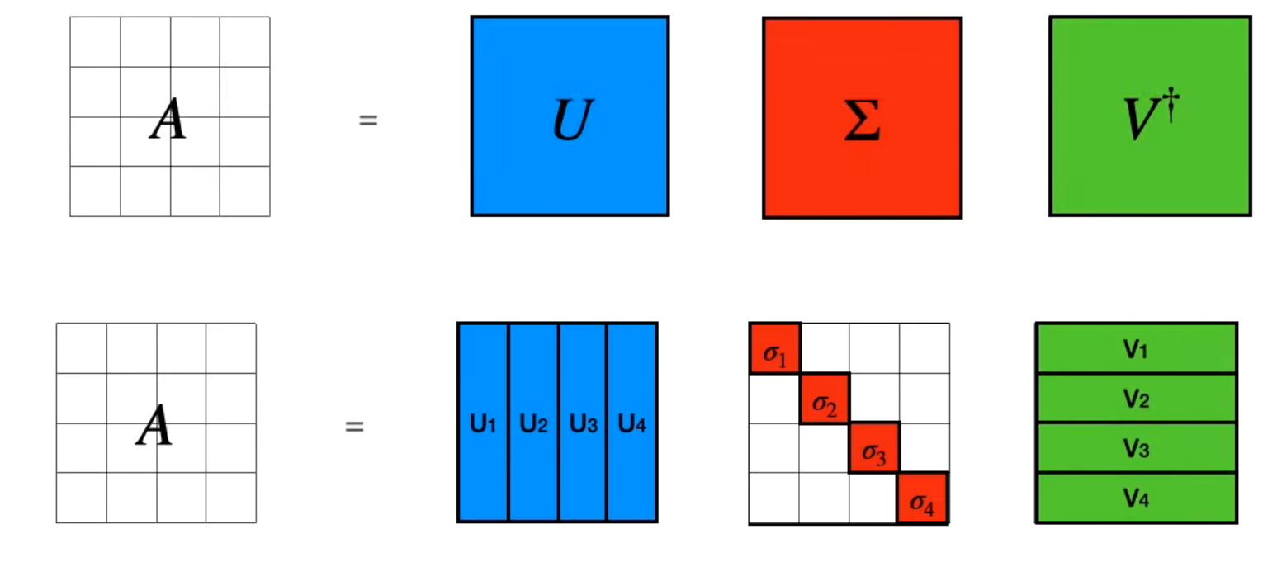

Slide 10
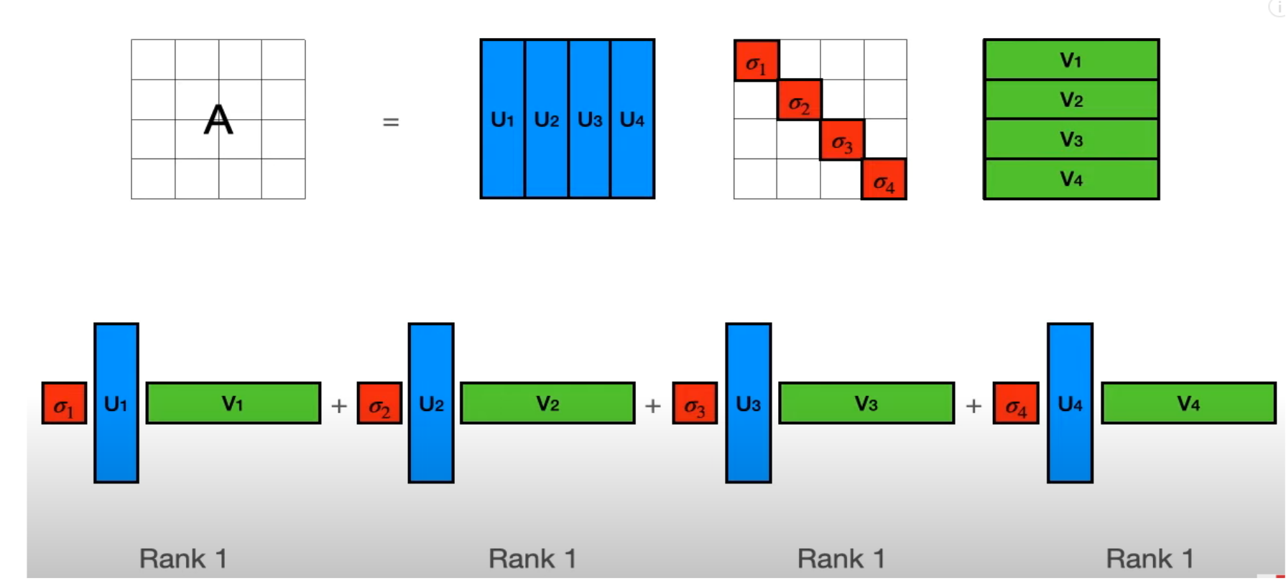

Slide 11
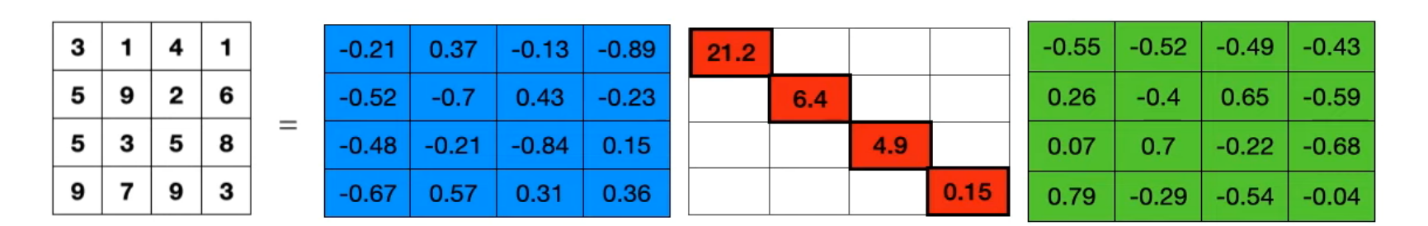

Slide 12
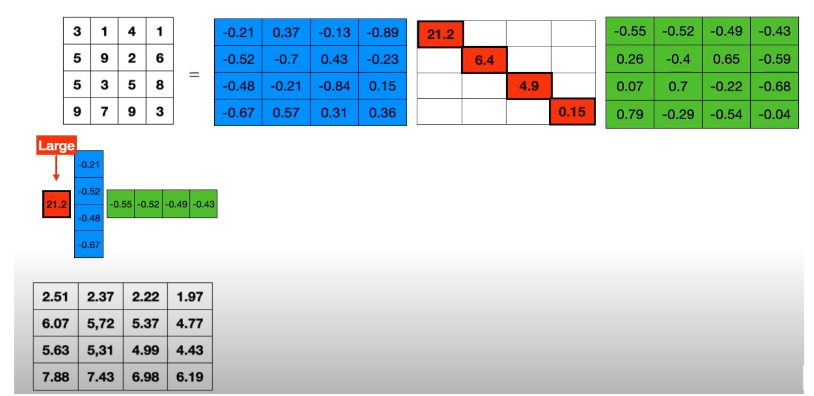

Slide 13
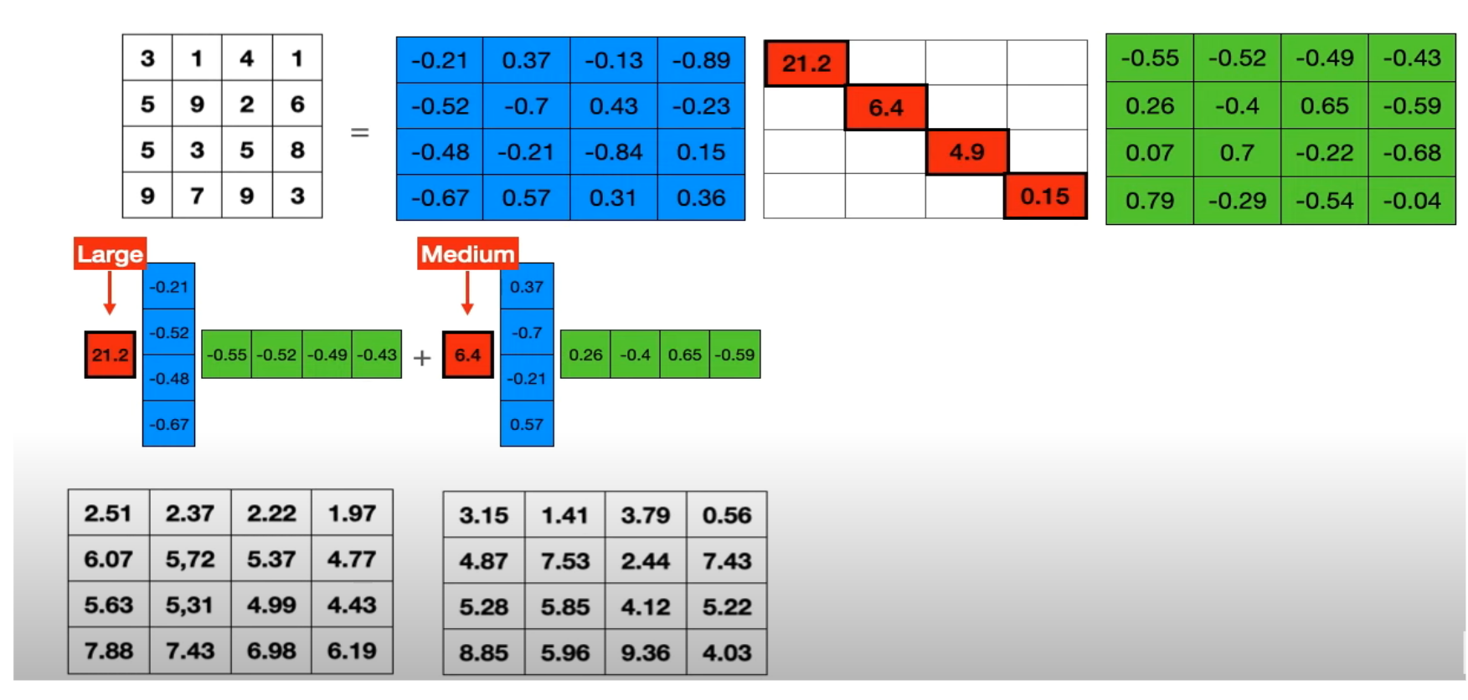

Slide 14
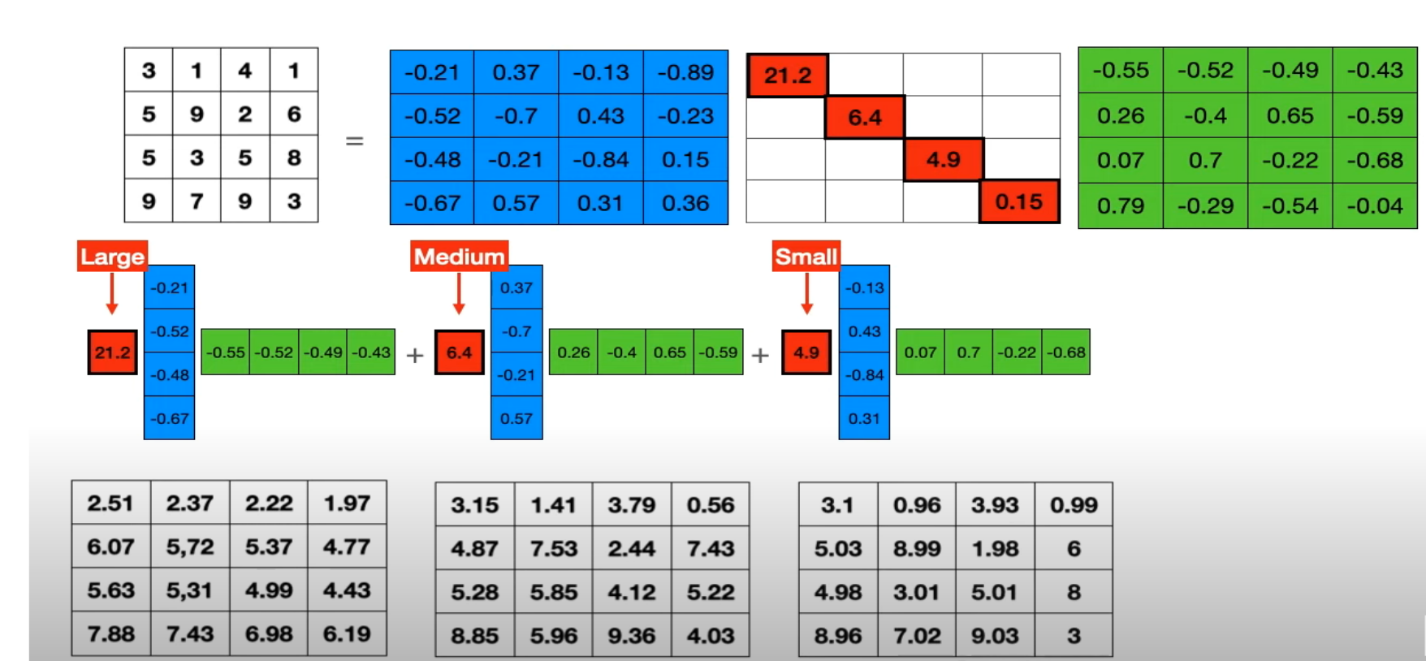

Slide 15
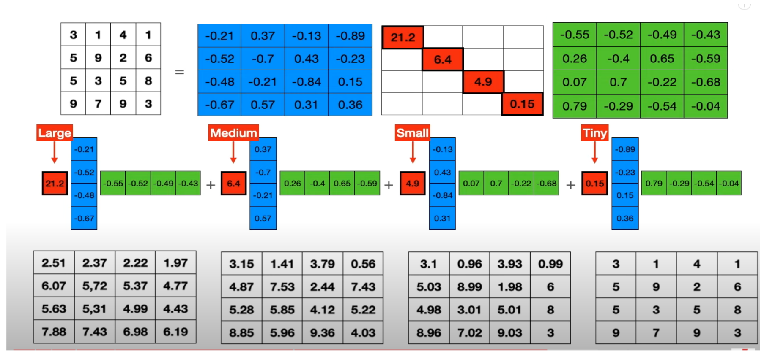

Slide 16
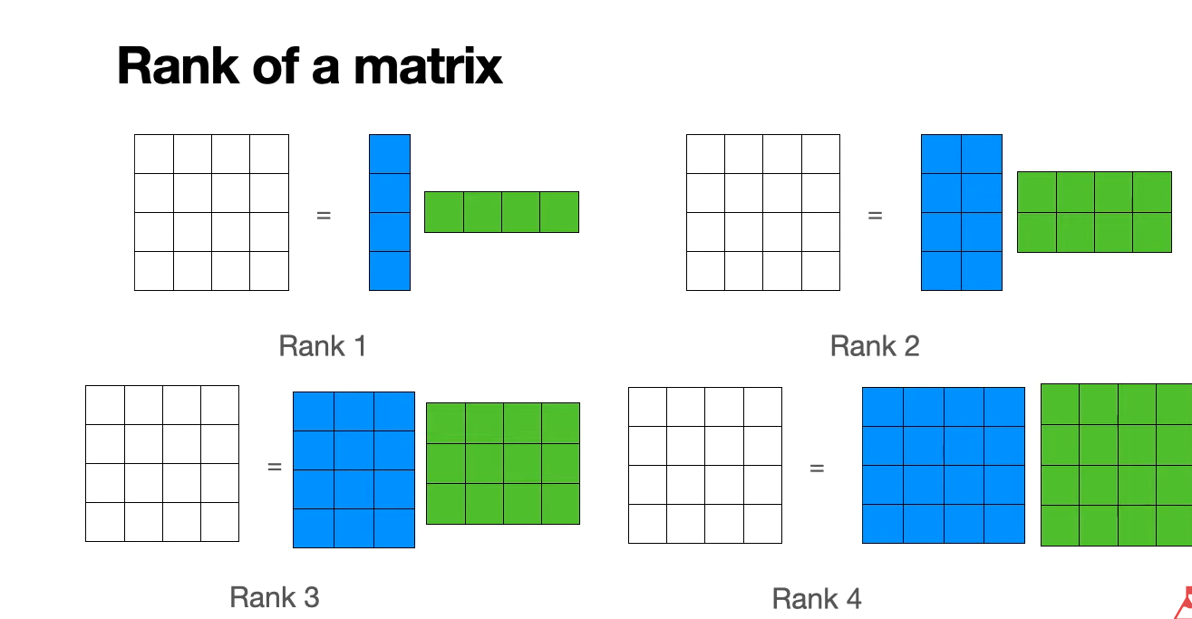

Slide 17
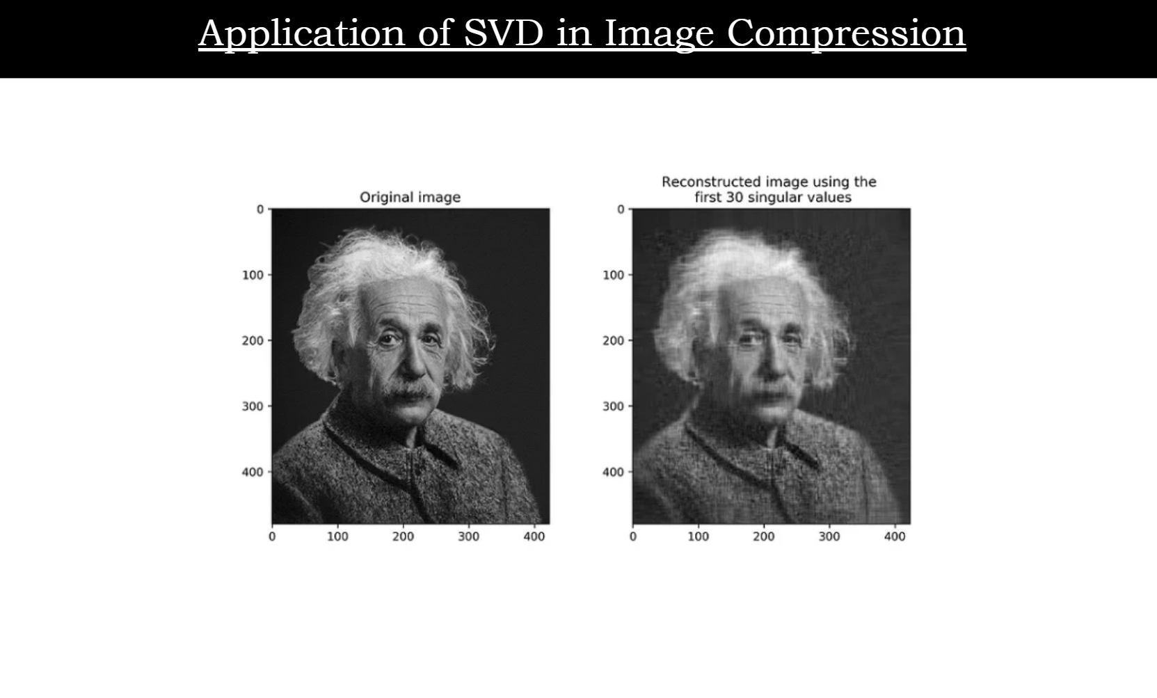

Slide 18
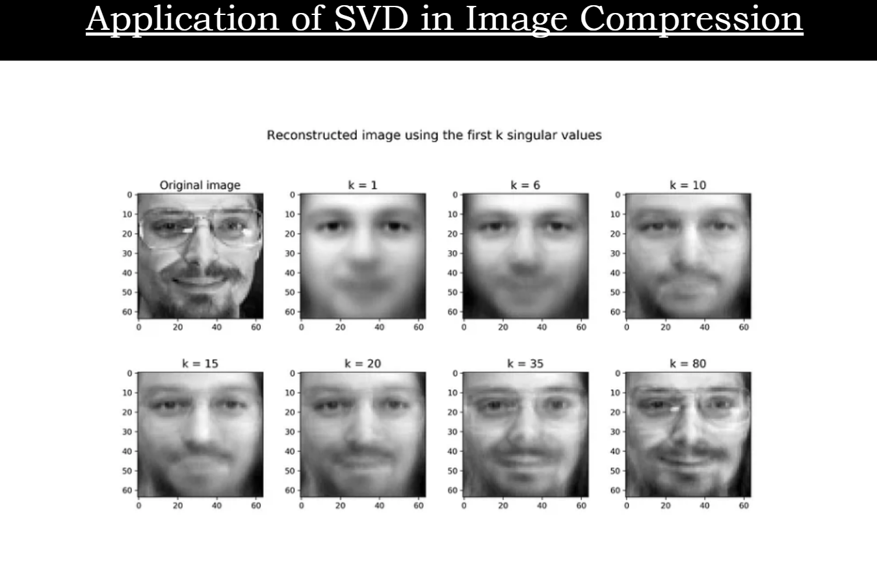

Slide 19
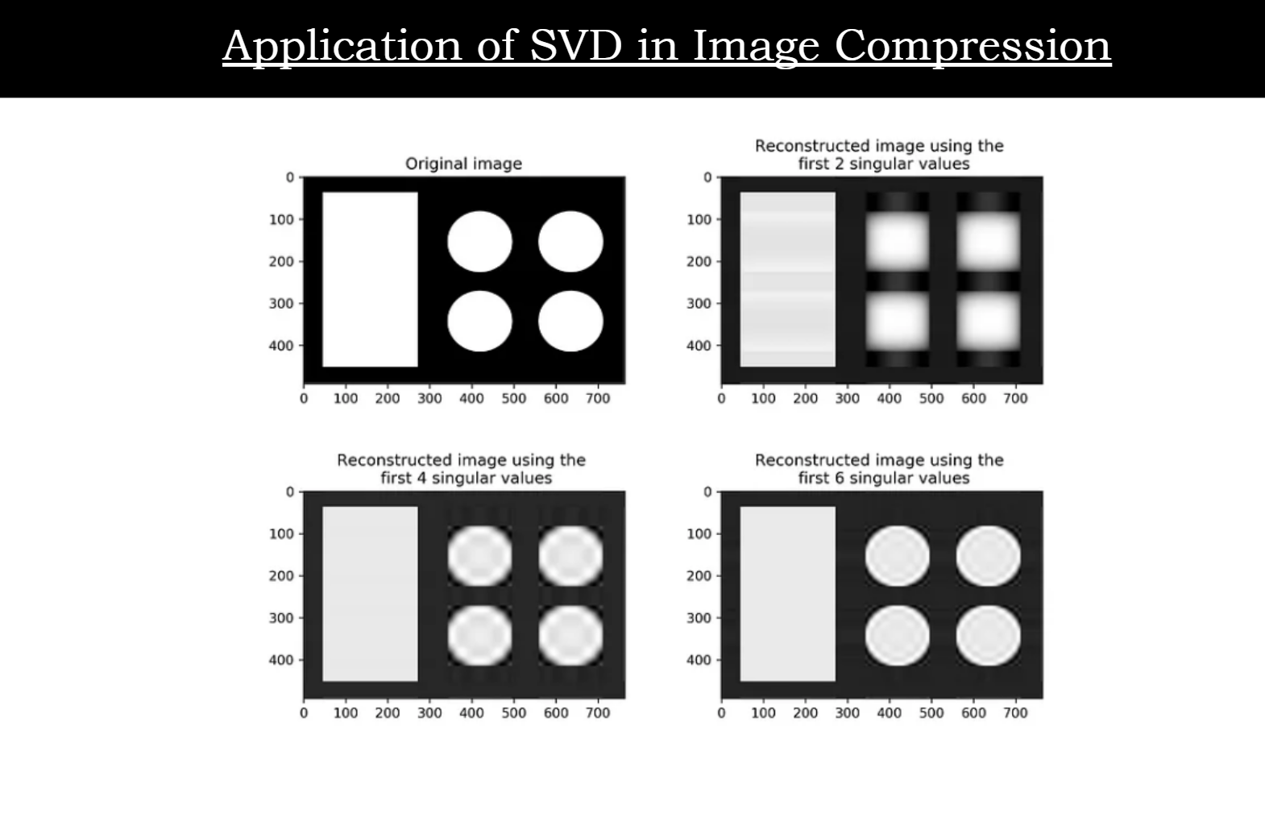

Slide 20
